Slide 1
Data Analysis: Red Bull Account Sales

Slide 2
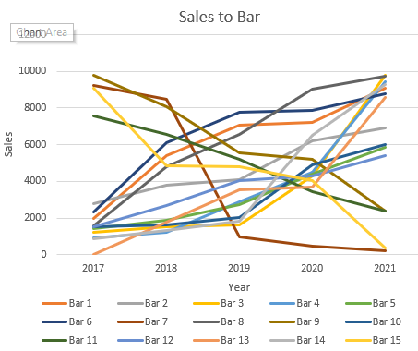
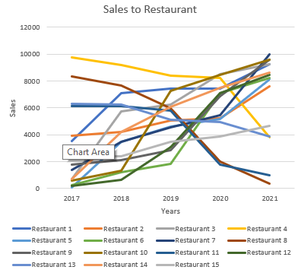
Sales Growth by Account and Account Type

Slide 3
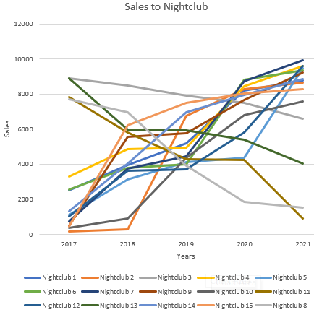
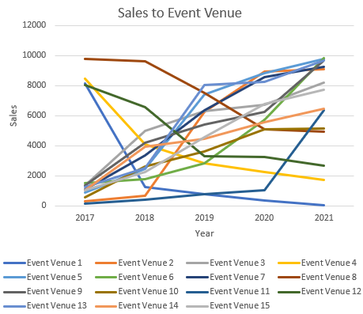
Sales Growth by Account and Account Type

Slide 4
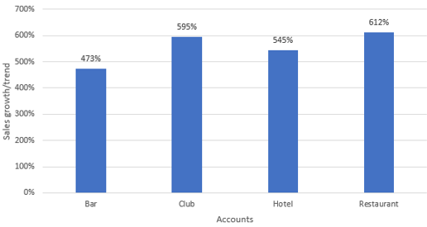
Sales Growth by Account Type

Slide 5
Best and Worst Performing Accounts by Account Type (5 Year CAGR)
Top 2 Accounts
Bar | Restaurant | Club | Event Venue
13 | 5 | 2 | 11
14 | 12 | 10 | 2
Bottom 2 Accounts
Bar | Restaurant | Club | Event Venue
7 | 8 | 11 | 1
15 | 11 | 8 | 4

Slide 6
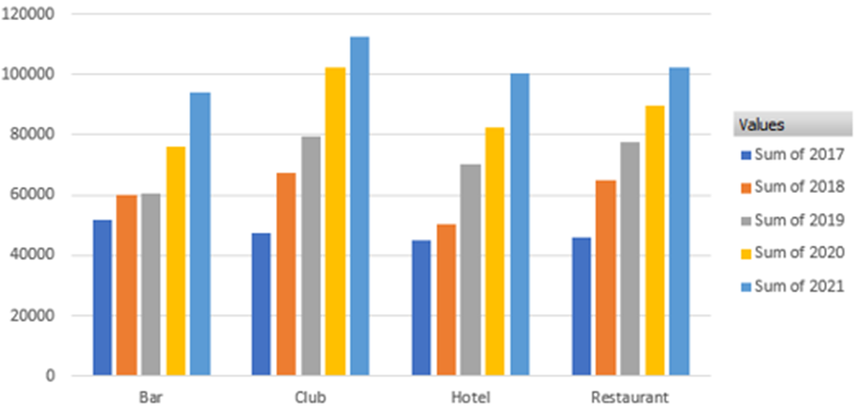
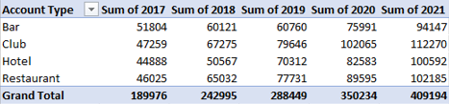
Total Sales by Account Type and Year

Slide 7
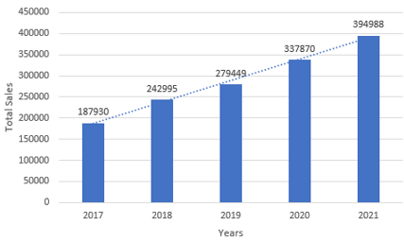
Sales Growth/Trends by Year

Slide 8
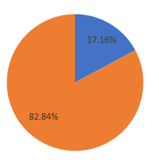
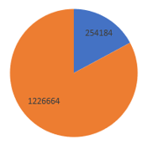

Effect of Sugar Free Presence on Sales

Slide 9
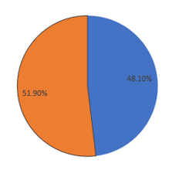

Effect of Yellow Edition on Sales

Slide 10
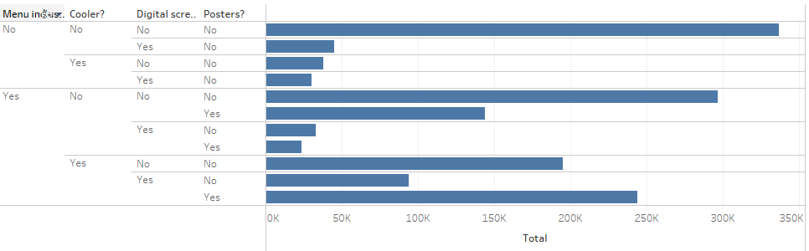
Effectiveness of the different Marketing/Promotions Program
From this chart we can understand that even thought there is no marketing/promotions, the sales have been highest.
Also considering individual marketing/promotions, we can see that the accounts with menu inclusion performs better than other marketing strategies.

Slide 11
Observations and Key Takeaways
We may infer from the data collected over the last five years that all categories of on-premise accounts have shown an increase in sales growth.
Sales Growth/Trends by Account Type
The restaurant has the highest growth rate and the bar has the lowest compared to other on-premise accounts, as shown by the graph for Sales Growth/Trends by Account Type.
Best and Worst Performing Accounts by Account Type
In order to increase sales in those on-premise accounts, we can compare the strategies and product lines of the best performing accounts with those of the worst performing accounts using the table for Best and Worst Performing Accounts by Account Type.
Marketing and Promotions Effectiveness
From the effectiveness of different marketing/promotions program we can understand that even thought there is no marketing/promotions, the sales have been highest. Also considering individual marketing/promotions for all the accounts, we can see that the accounts with menu inclusion performs better than other marketing strategies.

Slide 12
Observations and Key Takeaways
Considering individual types of accounts:
Bars with the highest sales growth tend to have the most promotion programs implemented.
Restaurants perform well when menu inclusion is implemented.
Nightclubs typically perform the best when digital screens are used to attract customers.
Event Venues perform well when coolers are displayed in the Venue.
Effect of Yellow Edition/Sugar Free on Sales
The pie chart demonstrating the impact of the yellow edition shows that when on-premise accounts are included, sales increase by 48.1%. This indicates that there is a higher desire for yellow edition than sugar free, which has a demand of 17.16%.
Even when different marketing strategies are used, the accounts perform better when all product kinds are offered, as can be seen by looking at just the two worst-performing accounts and comparing them to the top two accounts.
Overall, we may draw the conclusion that increasing the variety of products available and effectively implementing marketing strategies will increase sales.

